Slide 1

https://www.facebook.com/hcmut.ml.iot.lab
Neural network with Tensorflow, Keras
5/2021

Slide 2
A. Batch and epoch
in a neural network
‹#›

Slide 3
Sample is a single row of data. A training dataset is comprised of many rows of data (many samples)
Batch size is a hyperparameter: number of samples fed into model before updating the model parameters.
Batch size != number of
batches
1 batch is a set of samples
x₁₁ x₁₂ x₁₃
x₂₁ x₂₂ x₂₃
x₃₁ x₃₂ x₃₃
1 sample
.. .. ..

Slide 4
1 Epoch is comprised of one or more batches. 1 epoch means that each sample in the training dataset had an opportunity to update the model parameter.
The number of epochs is a hyperparameter: the number times the algorithm will work through the entire training dataset.
x₁₁ x₁₂ x₁₃
x₂₁ x₂₂ x₂₃
x₃₁ x₃₂ x₃₃
1 sample
.. .. ..
Notes:
neural_net3.py

Slide 5
B. Tensorflow
‹#›

Slide 6
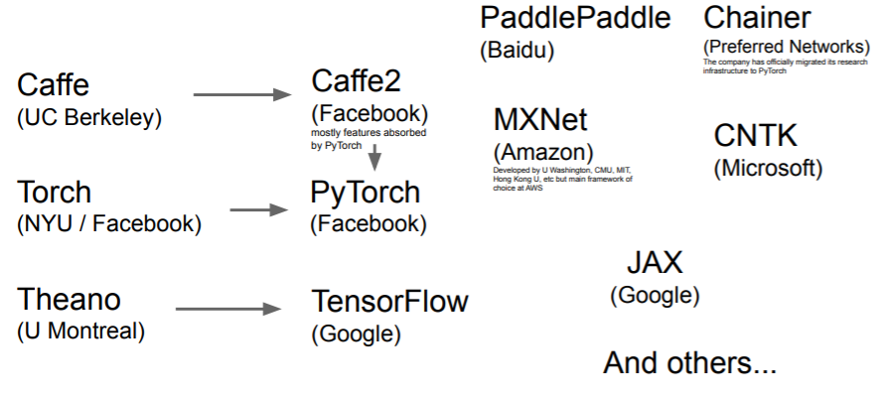
Frameworks
Notes:
Convex

Slide 7
Computations on Tensors
We can visualize computations in Tensorflow using graph.
These graphs are tensors holding data.
c = a + b
a
b
Notes:
Convex

Slide 8
Computations on Tensors
e = c * d
c = a + b
d = a - 1
a
b
Notes:
Convex

